Slide 1




Weekly report: Load & Dynamics
Week number: 12
Date: 16/12/2025
Supervisor: Mr. Manjock
Group members: Md Aman, Arham Memon, Paresh Nakum
Presenter – Paresh Nakum
16/12/2025
Paresh Nakum
Optimus Syria

Slide 2
Agenda For Loads & Dynamics
Final Procedure
Working Directory of MExtremes
MExtremes Tables
Bibliography
16/12/2025
Paresh Nakum
Load & Dynamics Team/ Optimus Syria

Slide 3
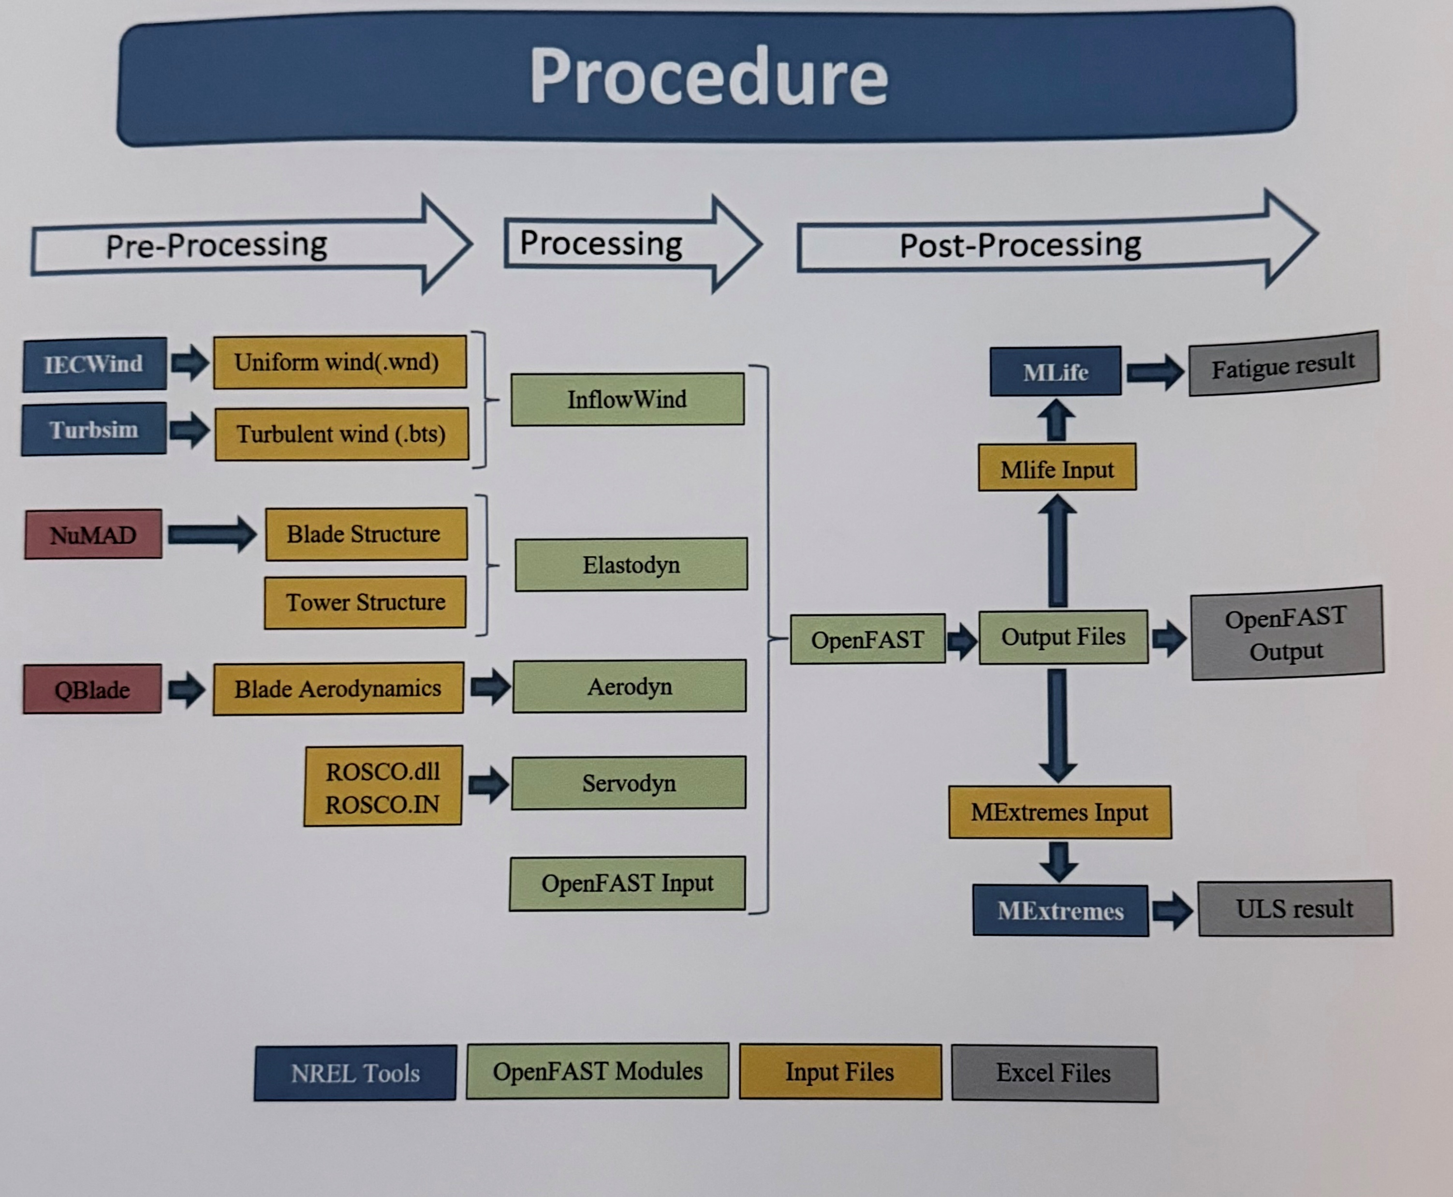
Final Procedure
Analyzed DLC File
Performed Extremes Test with MATLAB
Generated Extreme Table
Analysis started with scaled down value of Optimus Shakti
Done Done Almost Done
Source: Optimus Oceanus
16/12/2025
3
Paresh Nakum
Load & Dynamics Team/ Optimus Syria

Slide 4
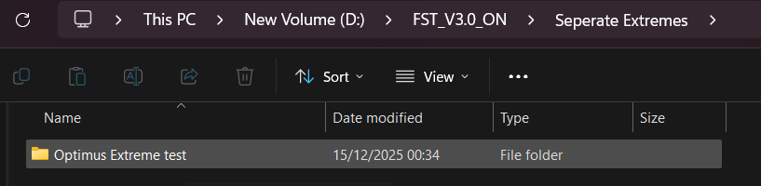
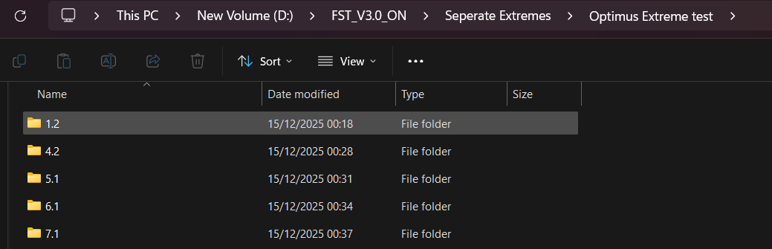
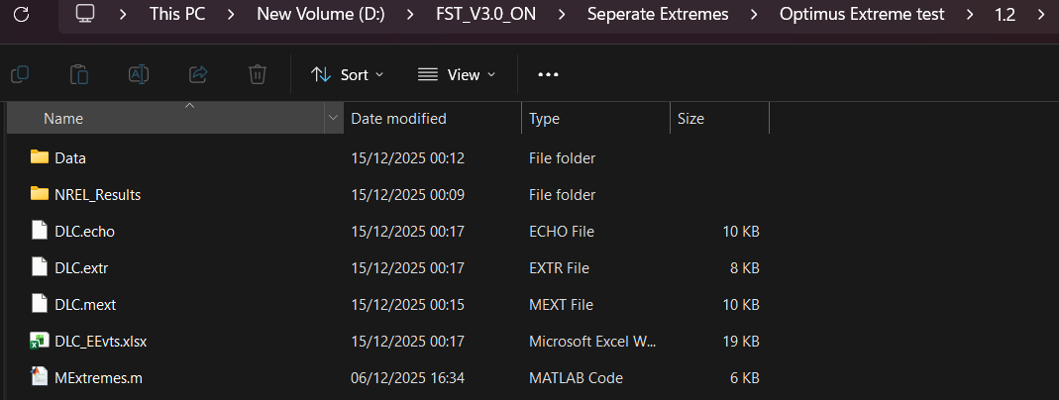
Working Directory
16/12/2025
4
Paresh Nakum
Load & Dynamics Team/ Optimus Syria

Slide 5
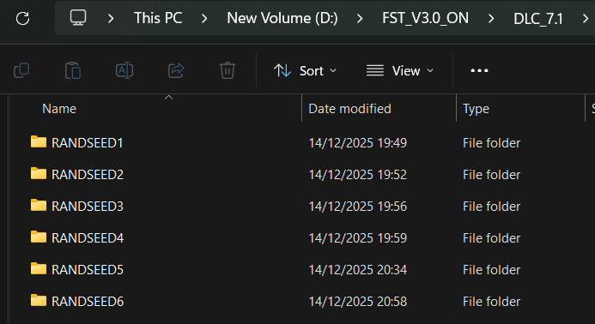
Working Directory
Analyzed DLC with Update
Every DLC has Analyzed with different different wind speed and for every wind speed has a total of 6 simulation for getting more accurate result.
A total of 245 output files is generated for analysis with all working DLC.
16/12/2025
5
Paresh Nakum
Load & Dynamics Team/ Optimus Syria

Slide 6
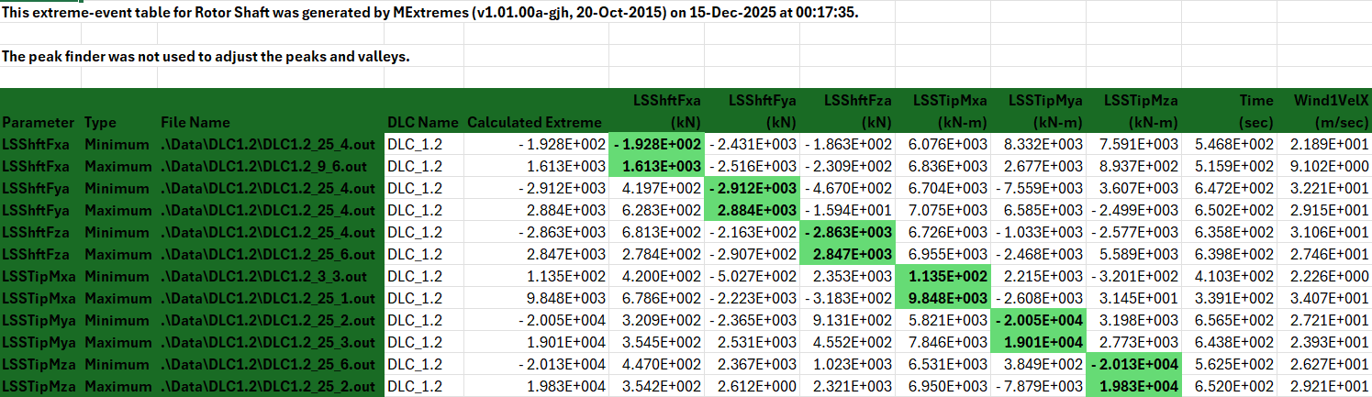
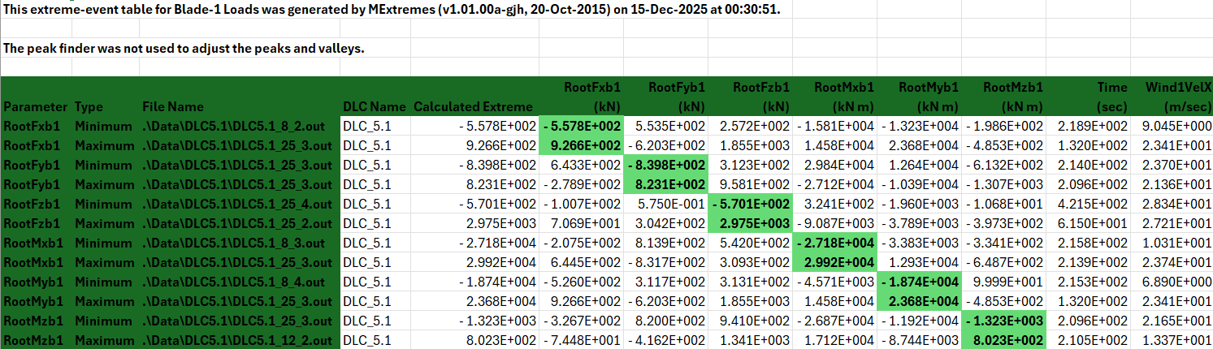
Extreme Tables
*Safety factor included
16/12/2025
6
Paresh Nakum
Load & Dynamics Team/ Optimus Syria

Slide 7


Extreme Tables
*Safety factor included
16/12/2025
7
Paresh Nakum
Load & Dynamics Team/ Optimus Syria

Slide 8
Conclusion
Analyzed DLC with Updated parameters with feedback controller result are optimized.
Generated Extremes with updated parameters.
Delivering Forces and moments to different group to analyze their scaled down value from shakti.
Working with Batch Extreme calculations.
16/12/2025
8
Paresh Nakum
Load & Dynamics Team/ Optimus Syria

Slide 9
References
Load Reports of the OPTIMUS Ocenaus
Standard, DNVGL-ST-0376 – Edition December 2016
TurbSim, OpenFAST_v3.0 & NREL 5 MW
MatLAB 2011b, MExtremes
16/12/2025
9
Paresh Nakum
Load & Dynamics Team/ Optimus Syria

